Slide 1
Electrical Circuits Lecture 9: Sinusoidal Steady State Analysis By: Mahmoud Momtazpour ceit.aut.ac.ir/~momtazpour
Amirkabir University of Technology

Slide 2
Topic Overview
Introduction: Sine Wave
Forced Response
Phasor

Slide 3
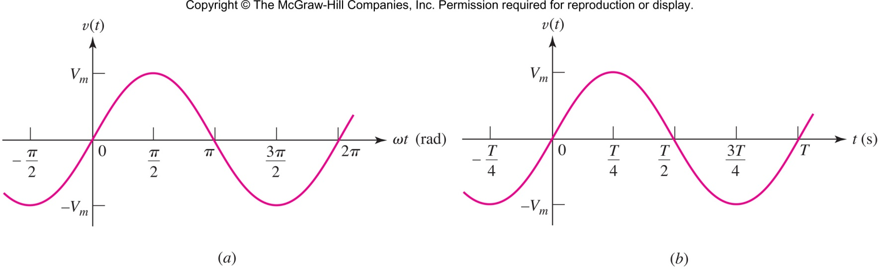
Sinusoids: Defining Terms
the amplitude of the wave is V_{m}
the argument is ωt
the radian or angular frequency is ω
note that sin() is periodic

Slide 4
Period of Sine Wave
the period of the wave is T
the frequency f is 1/T: units Hertz (Hz)

Slide 5
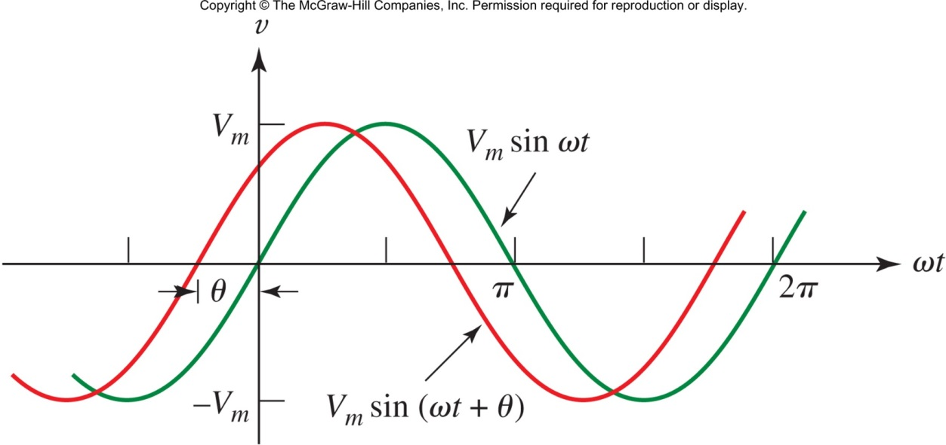
Sine Wave Phase
A more general form of a sine wave includes a phase θ
The new wave (in red) is said to lead the original (in green) by θ.
The original sin(ωt) is said to lag the new wave by θ.
θ can be in degrees or radians, but the argument of sin() is always radians.

Slide 6
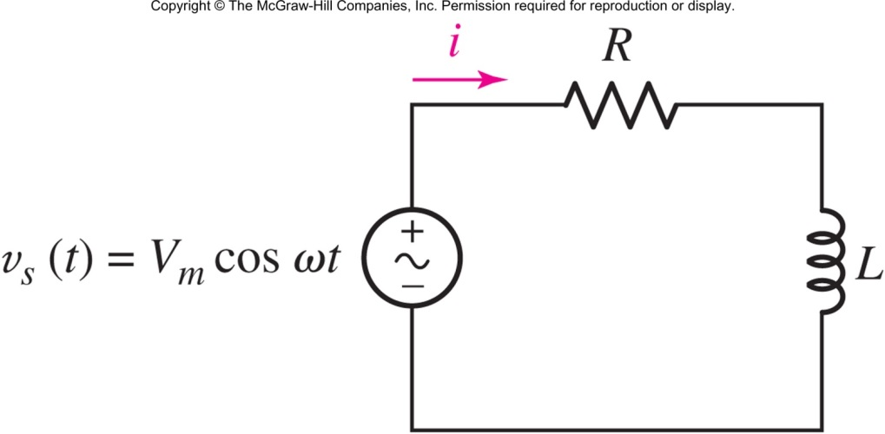
Forced Response to Sine Sources
When the source is sinusoidal, we often ignore the transient/natural response and consider only the forced or “steady-state” response.
The source is assumed to exist forever: −∞<t<∞

Slide 7
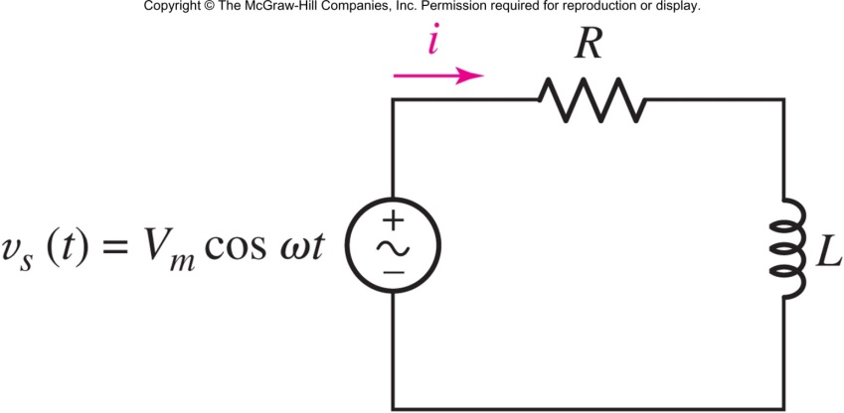
Finding the Steady-State Response
Apply KVL:
Make a good guess:
Solve for the constants:

Slide 8
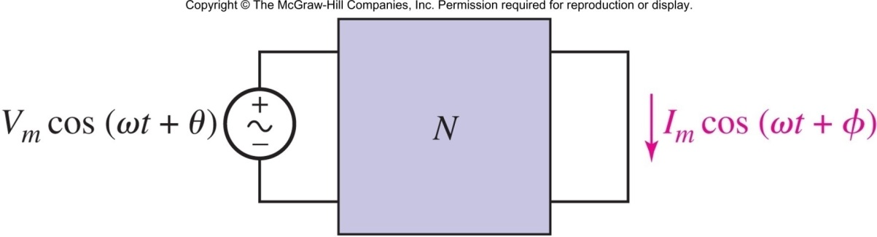
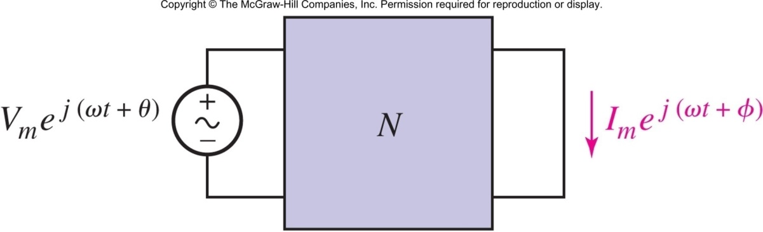
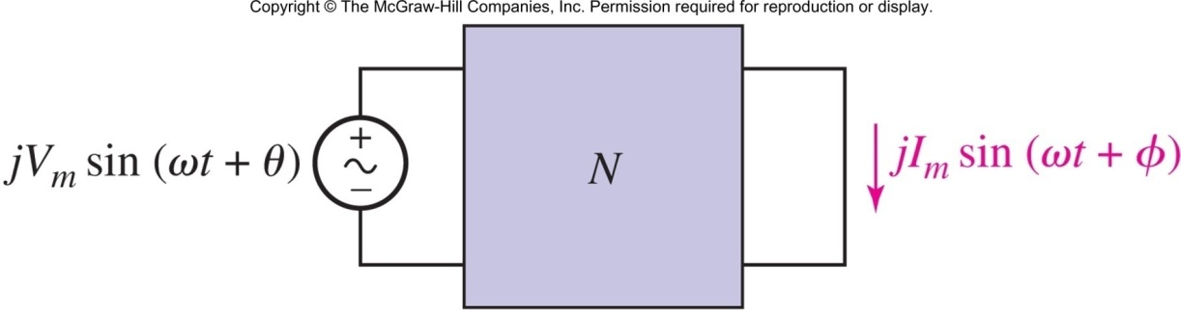
The Complex Forcing Function
Apply superposition and use
Notes:
خطی بودن مدار N باعث می شود که اگر ورودی مدار را K برابر کنیم خروجی هم K برابر شود. بنابراین اگر ورودی j برابر شود خروجی هم j برابر می شود. همچنین اگر ورودی به اندازه 90 درجه شیفت داده شود خروجی هم 90 درجه شیفت داده می شود. پس اگر خروجی مدار چپ بالا به آن صورت باشد، خروجی مدار چپ پایین هم به این صورت می شود.

Slide 9
The Steady-State Response via Complex Forcing Function
Apply KVL, assume v_{s}=V_{m}e^{jωt}.
Find the complex response
Find I_{m} and θ, (discard the imaginary part)

Slide 10
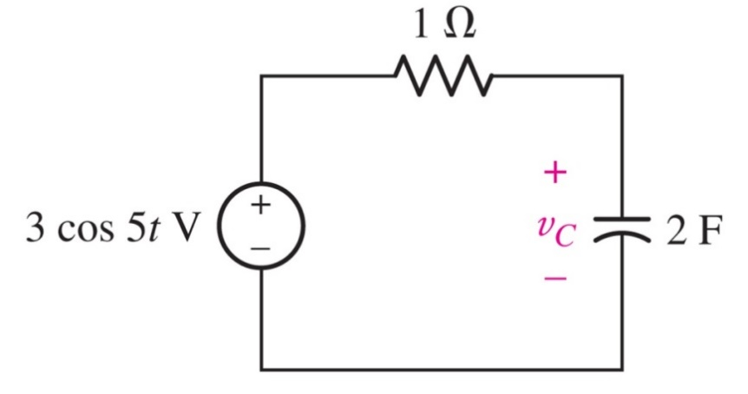
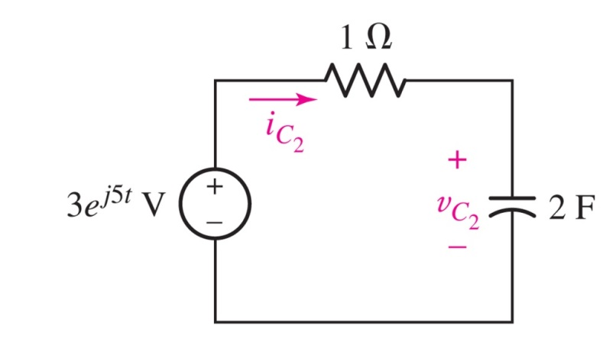
Example: Sine Wave Analysis
Find the voltage on the capacitor.
Answer: v_{c}(t)=298.5 cos(5t − 84.3◦) mV

Slide 11
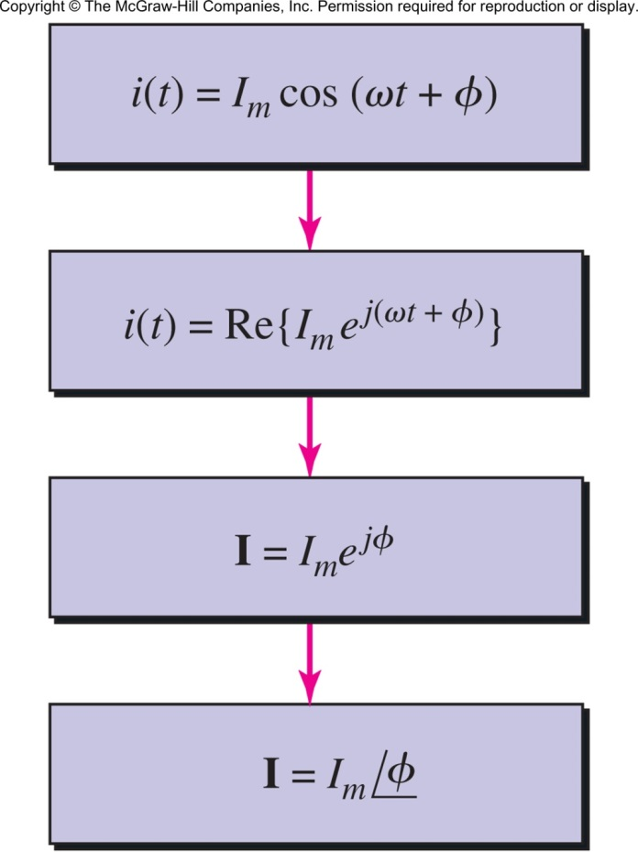
The Phasor
The term e^{jωt} is common to all voltages and currents and can be ignored in all intermediate steps, leading to the phasor:
The phasor representation of a current (or voltage) is in the frequency domain

Slide 12
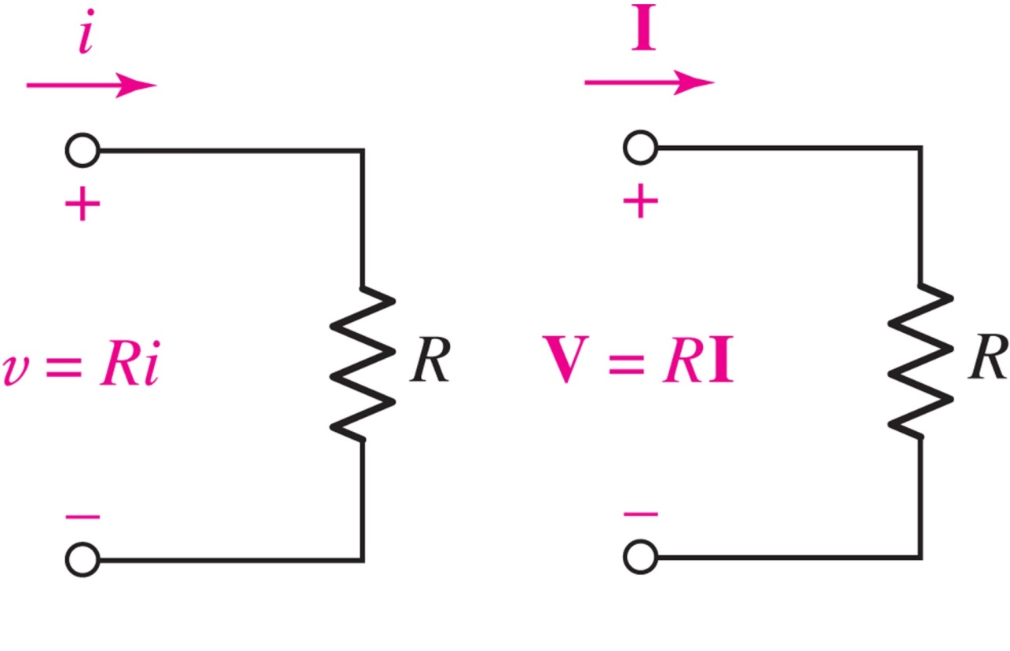
Phasors: The Resistor
In the frequency domain, Ohm’s Law takes the same form:

Slide 13
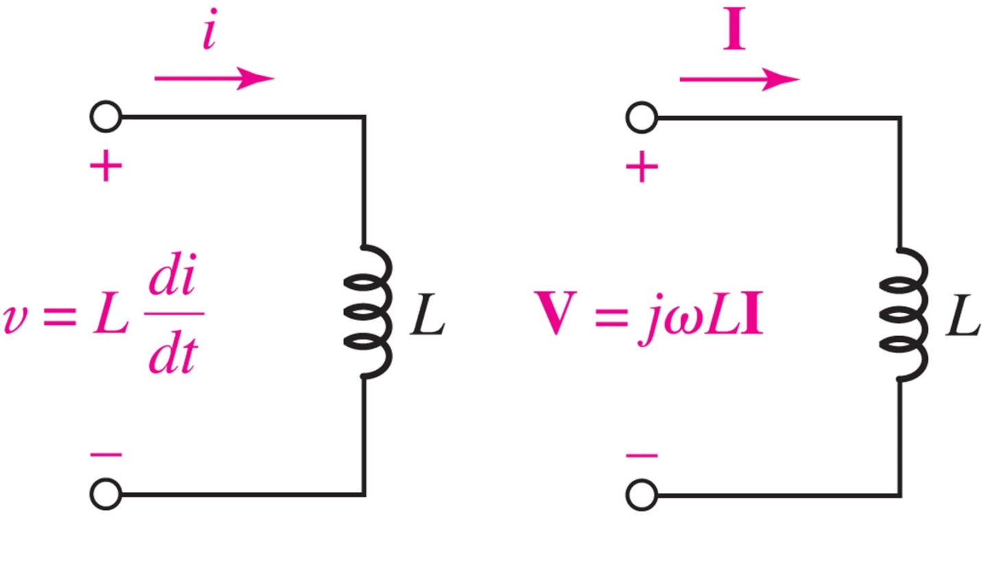
Phasors: The Inductor
Differentiation in time becomes multiplication in phasor form: (calculus becomes algebra!)

Slide 14
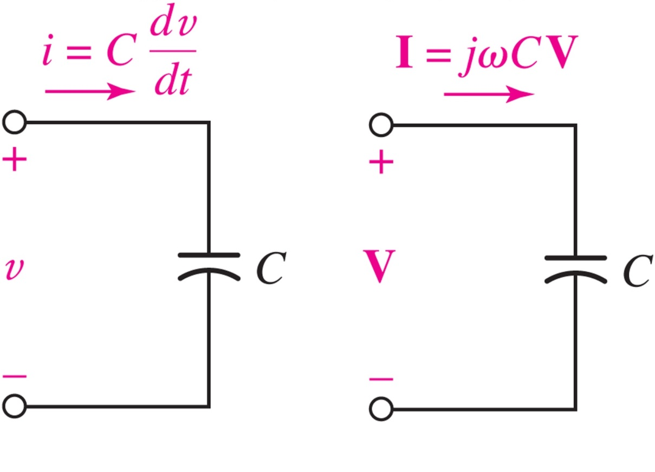
Phasors: The Capacitor
Differentiation in time becomes multiplication in phasor form: (calculus becomes algebra!)

Slide 15
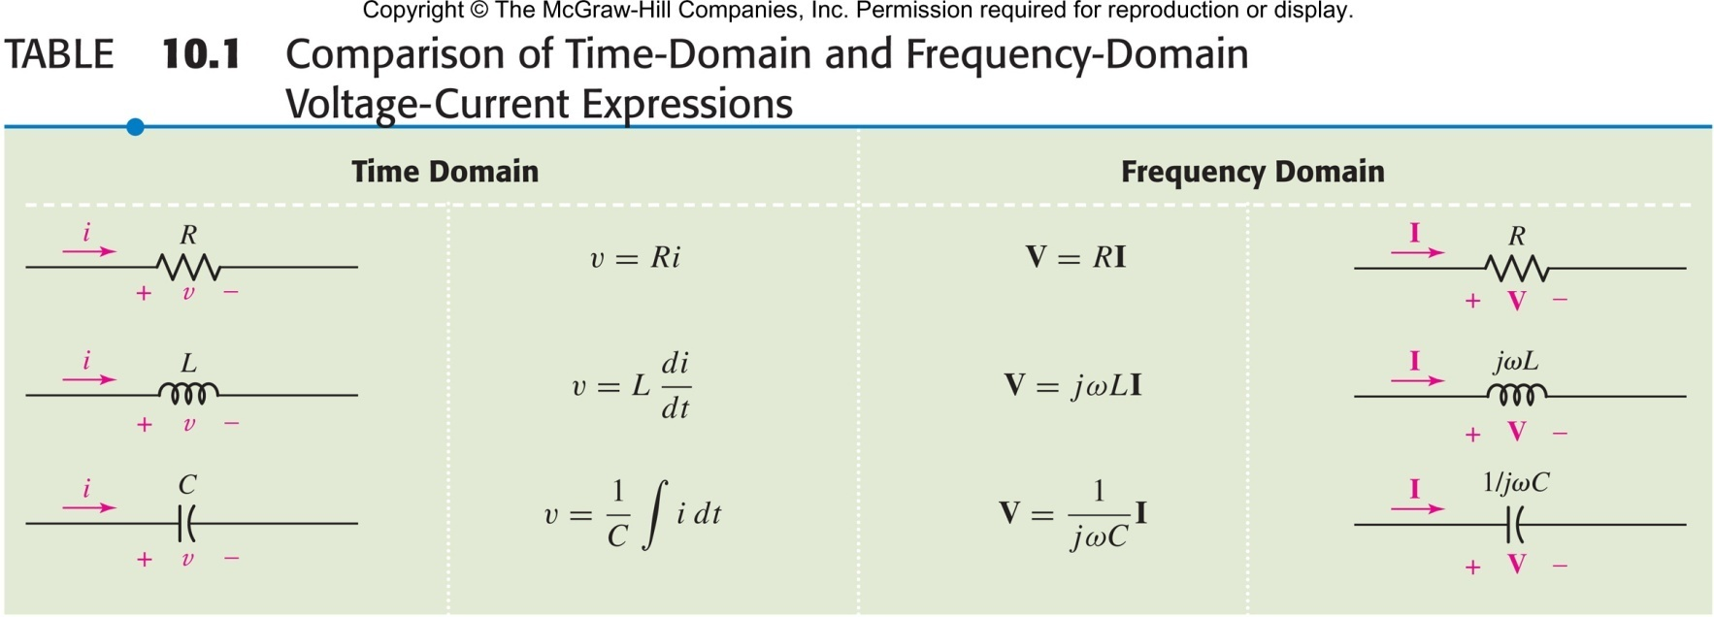
Summary: Phasor Voltage/Current Relationships
Time Domain Frequency Domain
Calculus (hard but real) Algebra (easy but complex)

Slide 16
Kirchhoff’s Laws for Phasors
Applying KVL in time implies KVL for phasors:
Applying KCL in time implies KCL for phasors:

Slide 17
Impedance
Define impedance as Z=V/I, i.e. V=IZ
Z_{R}=R Z_{L}=jωL Z_{C}=1/jωC
Impedance is the equivalent of resistance in the frequency domain.
Impedance is a complex number (unit ohm).
Impedances in series or parallel can be combined using “resistor rules.”

Slide 18
Impedance Relationships
the admittance is Y=1/Z
Y_{R}=1/R Y_{L}=1/jωL Y_{C}=jωC
if Z=R+jX; R is the resistance, X is the reactance (unit ohm Ω)
if Y=G+jB; G is the conductance, B is the susceptance: (unit siemen S)

Slide 19
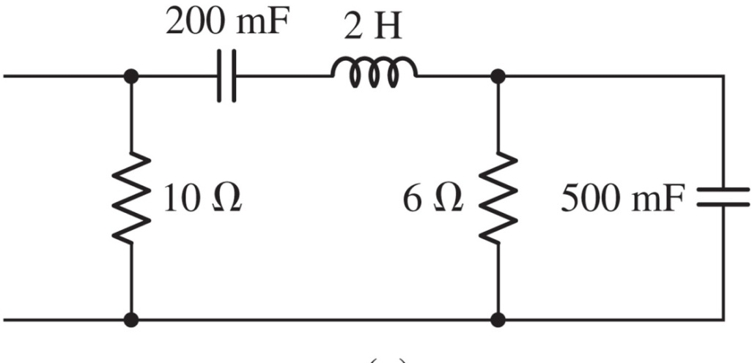

Example: Equivalent Impedance
Find the impedance of the network at 5 rad/s.
Answer: 4.255 + j4.929 Ω

Slide 20
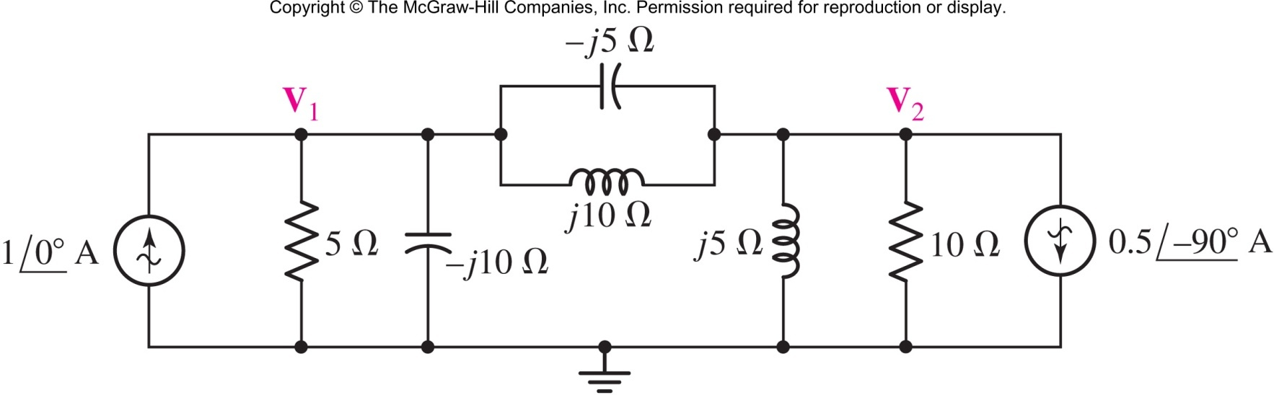
Nodal and Mesh Analysis
Find the phasor voltages V₁ and V₂.
Answer: V₁=1-j2 V and V₂=-2+j4 V

Slide 21
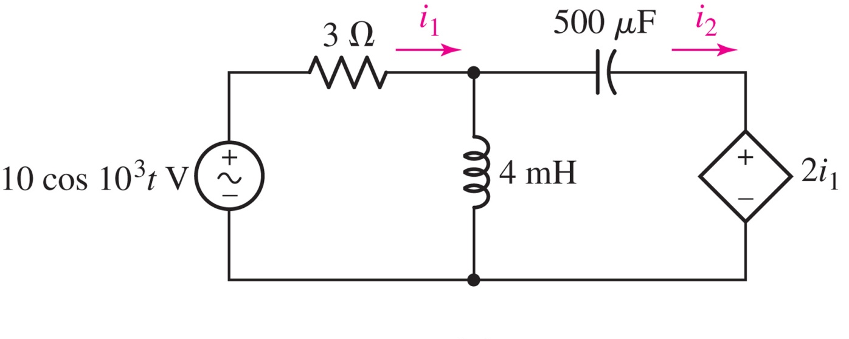
Nodal and Mesh Analysis
Find the currents i₁(t) and i₂(t).
Answer:
i₁(t) = 1.24 cos(10³t + 29.7◦) A
i₂(t) = 2.77 cos(10³t + 56.3◦) A

Slide 22
Superposition Example
The superposition principle applies to phasors; use it to find V₁.
Answer: V₁=V_{1L} +V_{1R} =(2-j2)+(-1) = 1-j2 V

Slide 23
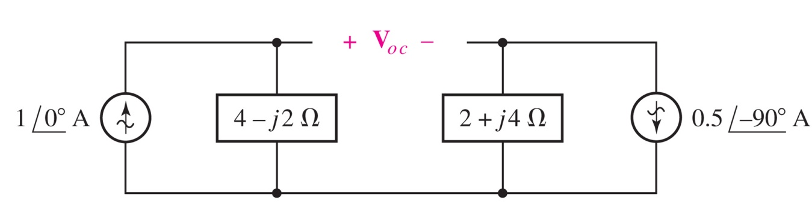
Thévenin Example
Thévenin’s theorem also applies to phasors; we can use it to find V₁.
The setup is shown below:

Slide 24
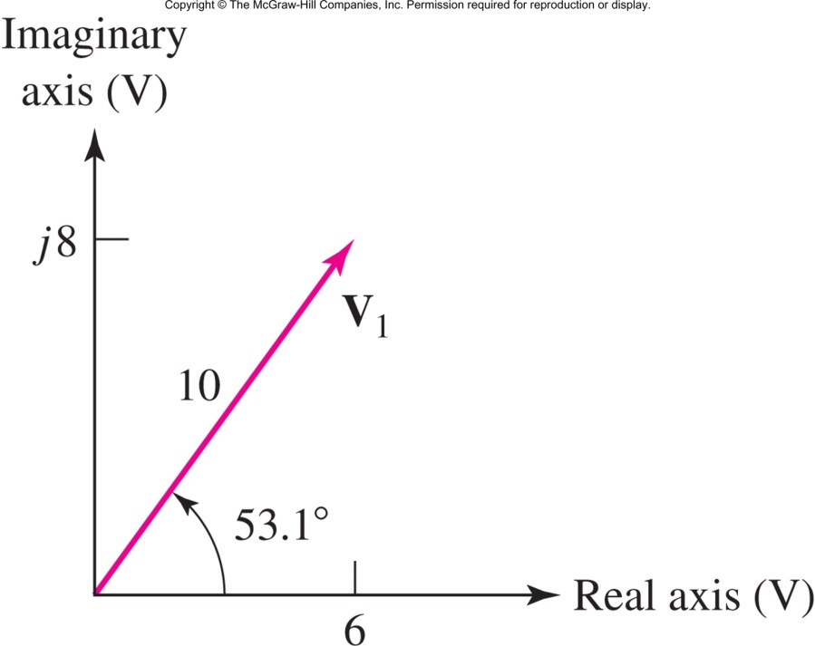
Phasor Diagrams
The arrow for the phasor V on the phasor diagram is a photograph, taken at ωt = 0, of a rotating arrow whose projection on the real axis is the instantaneous voltage v(t).

Slide 25
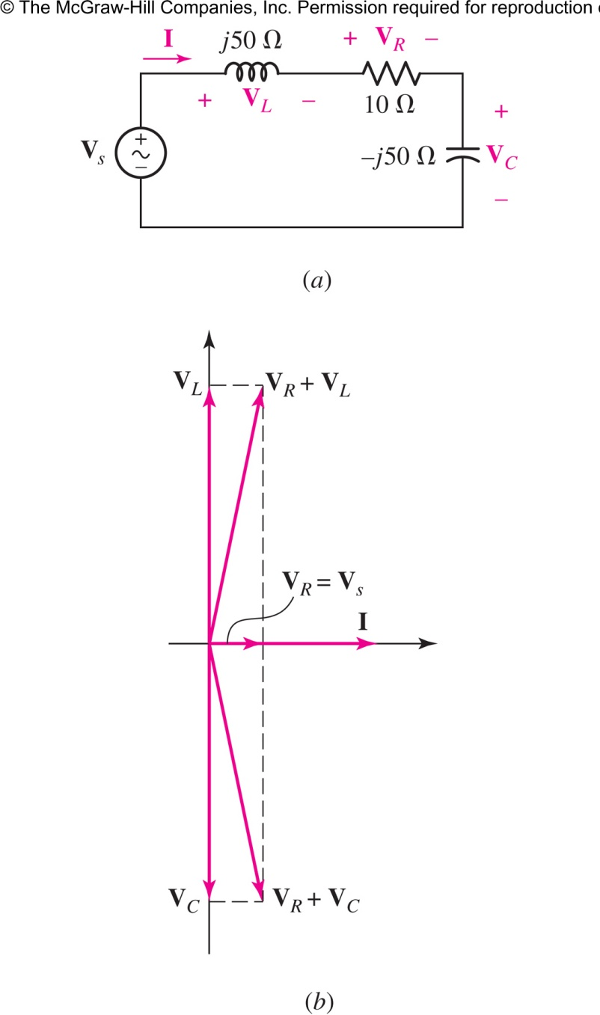
Example Phasor Diagram
If we assume I=1 ⁄ 0° A
Notes:
Inductor current lags inductor voltage by 90º مفهوم پس فاز یا عقب افتادگی :
Capacitor current leads capacitor voltage by 90º مفهوم پیش فاز یا جلو افتادگی :

Slide 26
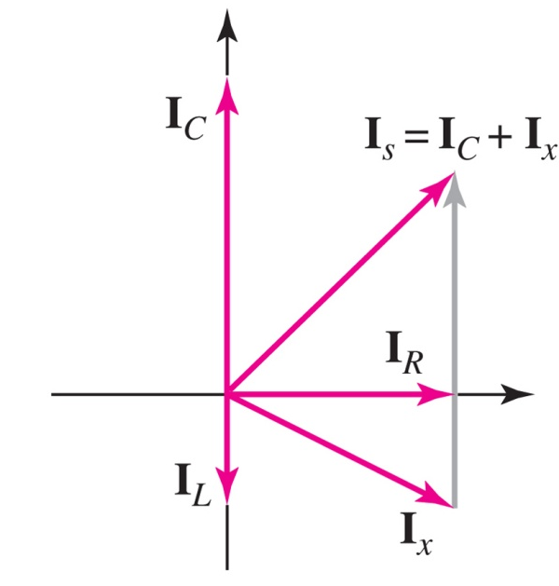
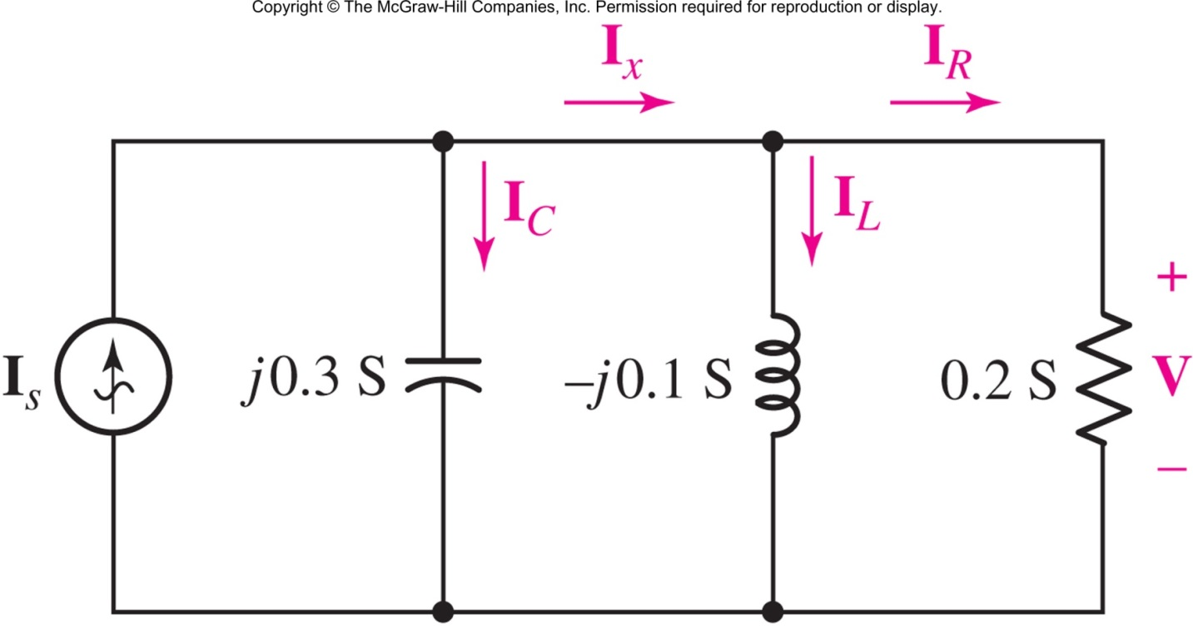
Phasor Diagram: Parallel RLC
Assume V = 1 /0◦ V

